Slide 1
Role Of Computed Tomography In Pediatric Ventricular Assist Device Fitting
Presented by: Abhijit (Abhi) Bhattaru
Animesh Tandon, Ryan Davies, David Sutcliffe, Ryan Butts, Jeanne
Dillenbeck, Gerald Greil, Tarique Hussain
Drs. Tandon and Hussain have significant ownership interest in VARYFII Imaging. Other authors declare no conflicts of interest

Slide 2
Introduction

Slide 3
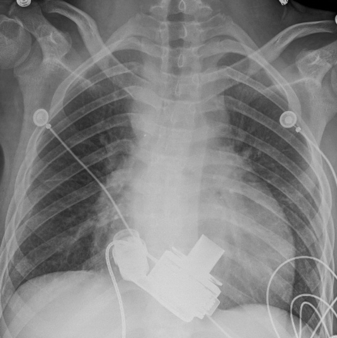
Gamal Marey, Kristy M. McHugh, Alyssa M. Sakhitab-Kerestes, Subin Jang, Marie E. Steiner, Ranjit John, Martina Richtsfeld, Sameh M. Said, Rebecca Ameduri, Massimo Griselli. HeartMate III as a Bridge to Transplantation in an Adolescent With Failed Fontan Circulation. J Am Coll Cardiol Case Rep. 2019 Dec, 1 (4) 512-515.

Slide 4
Methodology

Slide 5
17 total patients with VAD fit 2018-2019
8 Patients fit uncertainty
7 Cardiac CT
1 Cardiac MRI

Slide 6
Image Segmentation
Rendered 3D objects
Virtual Reality Simulation
VAD Evaluation
Includes the atrial mass/ventricular mass, chest wall and diaphragm.
Mimics & 3-Matic version 20
Created 3D stl files based on image segmentation
Brought in patient scan into VR space along with stl files of various VAD devices
HTC Vive Headset
Likert Scale used to determine accuracy.
Reviewed post implantation.

Slide 7
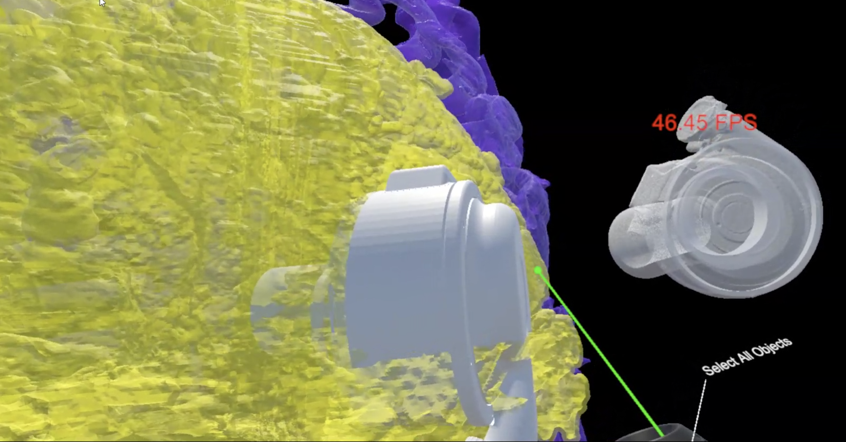
Figure 1. Image of VR space with both HeartMate3 and HeartWare devices tested for fitting in patient chest.

Slide 8
Results

Slide 9
Demographics
Fit assessment
5 Females 3 Males
Mean Age 10.2 (range 6.59-14.2)
BSA mean 1.04 m² (range 0.74-1.52)
3 Fully Retrospective CT
3 Non-gated flash CTA
1 Prospective Adaptive CT
1 VCG-gated 3DSSFP MRI
6 Diastole 2 Systole (non-gated)
3 LVAD and 5 BiVAD placements
5 HeartMate3 and 3 HeartWare devices
Device choice and fit determined with VR was accurate in all cases.
Surgeons were able to use previous patient VR scans to compare chest size and device fit.
VR simulation was deemed invaluable for all eight cases and provided insight simple linear dimensions from imaging was unable to provide

Slide 10
Future of VAD

